Slide 1
Quality Management in Projects
Muhammad Fahad Bashir

Slide 2
Quality Management?
Ensures the project deliverables meet defined standards and satisfy customer expectations.
Term | Meaning
QA (Quality Assurance) | Process-focused – prevent defects (standards, planning)
QC (Quality Control) | Product-focused – detect defects (inspection, testing)

Slide 3
Key Activities
Define quality objectives
Plan test strategy
Set up tools like Zephyr/TestRail in JIRA
Ensure test coverage and metrics
Conduct audits & reviews

Slide 4
Tools Integration
Zephyr in JIRA
Zephyr for JIRA allows you to:
Create and manage test cases inside JIRA
Link test cases to user stories
Run test cycles and track execution
View real-time test dashboards
🔗 Alternatives: TestRail, Xray, QMetry

Slide 5
Activity
Task | Tool | Outcome
Create a test plan for “Place Order” feature | JIRA + Zephyr | Document test objectives
Write 3 test cases inside JIRA | Zephyr plugin | Connect with stories
Mark test status: Pass/Fail | Zephyr Test Cycle | Visual progress
Link bugs to failed test cases | JIRA | End-to-end QA tracking

Slide 6
Risk Management?
Risk Management is the process of identifying, analyzing, and responding to potential events that could negatively impact your project.
Step | Description
1. Identify Risks | List everything that could go wrong
2. Analyze Risks | Assess impact and likelihood (High/Med/Low)
3. Prioritize Risks | Focus on the most critical ones
4. Plan Risk Responses | Mitigate, avoid, accept, transfer
5. Monitor and Control | Track ongoing and emerging risks

Slide 7
Example Risks
ID | Risk | Impact | Likelihood | Response Plan
R1 | API downtime | High | Medium | Add monitoring + retry logic
R2 | Data leak | Critical | Low | Use HTTPS, secure auth
R3 | Delay from UI team | Medium | High | Add buffer in timeline
R4 | Unreliable vendor | High | Medium | Have backup vendor ready

Slide 8
Activity
Activity | Tool
Create a Risk Register | Google Sheet or Excel
Add top 5 project risks | Based on team brainstorming
Create JIRA task per risk | Use Label: risk and set due dates
Add custom fields | Risk Level (High/Low), Owner, Mitigation Plan

Slide 9
Procurement in Projects?
Procurement is the process of buying or acquiring products/services from outside vendors (e.g., hosting, design services, food API provider).
Concept | Explanation
Vendor Selection | Comparing potential suppliers based on quality, cost, reliability
RFP (Request for Proposal) | A document you send to vendors asking for offers
Contract Management | Ensuring vendors deliver on time and within budget
Procurement Timeline Tracking | Using JIRA to assign procurement tasks and track deadlines

Slide 10
Example
Vendor | Purpose | Selection Criteria
Hosting Provider | App deployment | Uptime, cost, region
Payment Gateway | Future upgrade | API ease, transaction fees
Figma Designer | UI Design | Portfolio, timeline
SMS API | Order alerts | Local coverage, reliability

Slide 11
Activity
Activity | Tool
Create simple RFP (1-pager) | Google Docs / Word
Compare 2 vendor options | Google Sheets (comparison matrix)
Create JIRA Epic: “Procurement” | Subtasks: Evaluate vendors, draft RFP, finalize contract
Add Custom Fields | “Vendor Name”, “Contract Value”, “Expected Delivery Date”

Slide 12
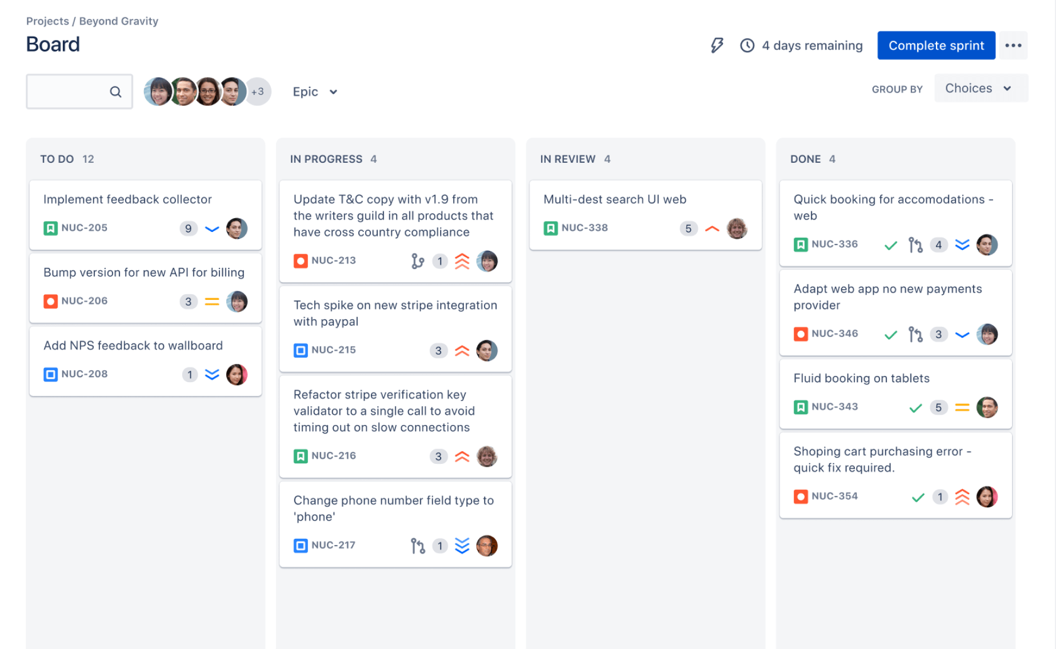
Agile Board
An Agile Board is a visual tool (in JIRA, Trello, etc.) used to manage work-in-progress, track sprint progress, and keep teams aligned.
Board Type | Best For
Scrum Board | Sprint-based teams, fixed timeboxes (2 weeks)
Kanban Board | Continuous flow, no sprints, works on queues and limits

Slide 13
Scrum vs Kanban
Feature | Scrum | Kanban
Planning | Sprint-based | Continuous
Roles | Scrum Master, PO, Devs | Optional
Tasks | Estimated, sprint-scoped | Pulled based on flow
Tracking | Burndown chart | Cycle time, WIP limit
Notes:
An Agile Board is your team’s command center. It helps turn planning into execution, track progress, and adapt quickly — whether you ship every 2 weeks (Scrum) or continuously (Kanban).”

Slide 14
Connecting All Dots [week 4 & 5 ]
You now saw how a Project Manager:
Gathers stakeholders 🧑‍💼
Plans scope & timelines 📅
Manages risks & vendors 📉
Tracks work & ensures quality 💡
Uses tools like JIRA & Hubstaff to keep the team aligned 🔄

